Slide 1
Chips Retail Analytics
31 July 2023
Gidion Buranda
Brand note: If client logo is not required, use alternate title page layout right click slide thumbnail > Layout > Title

Slide 2
01 Business Understanding
Quantium’s retail analytics team has been approached by Chips Retail. As of June 2023, this retail already has 72,636 unique customers and reaches 42,060 orders every month.

Slide 3

Goals
To gain a deeper understanding of the customer segments that purchase Chips and their purchasing behavior.
To provide personalized recommendations for each customer segment based on their purchasing behavior.

Slide 4


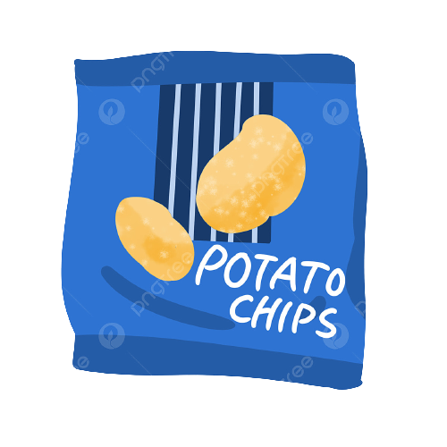

About the data
There are 3 customer segmentation :
Premium Customer
Budget Customer
Mainstream Customer
72,636 unique
customers
21 unique
chips brand
And 6 kind of family lifestage :
YOUNG SINGLES/COUPLES
YOUNG FAMILIES
OLDER SINGLES/COUPLES
MIDAGE SINGLES/COUPLES
NEW FAMILIES
OLDER FAMILIES
RETIREES
272 retails

Slide 5
02 Visualization & Insights
Several visualizations of retail data that have been cleaned to produce an interesting insight

Slide 6
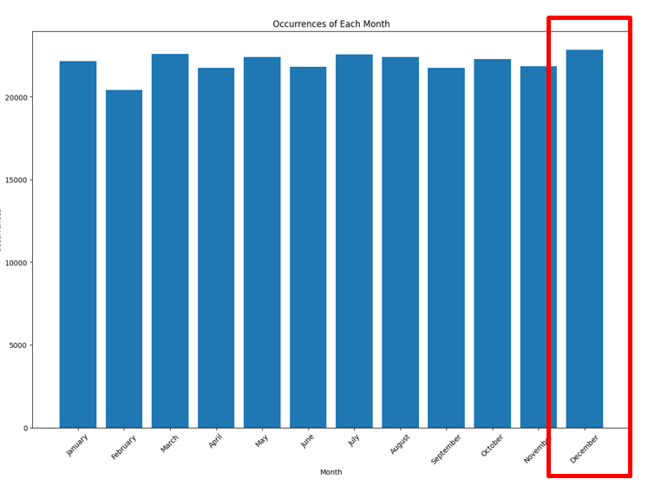
December is the month with the most purchases

Slide 7
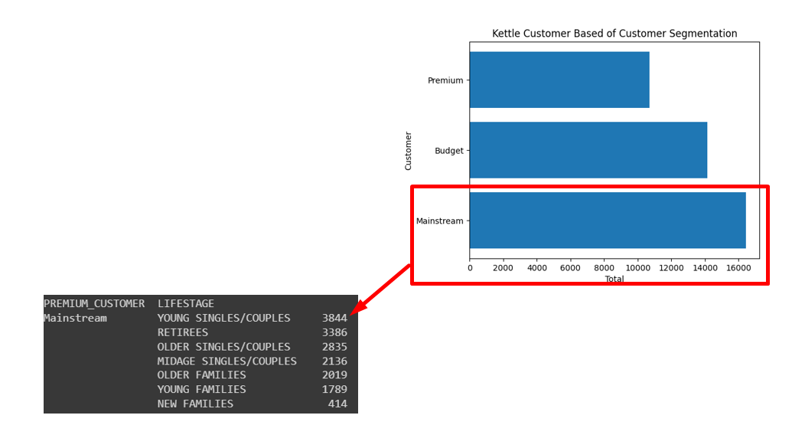

Kettle is the most frequently purchased brand
Most of the customers who buy the Kettle brand are mainstream customers, with the majority being young singles / couples

Slide 8
03 Customer Segmentation
From the previous insights, we can infer certain behavioral patterns within families based on customer segments.

Slide 9

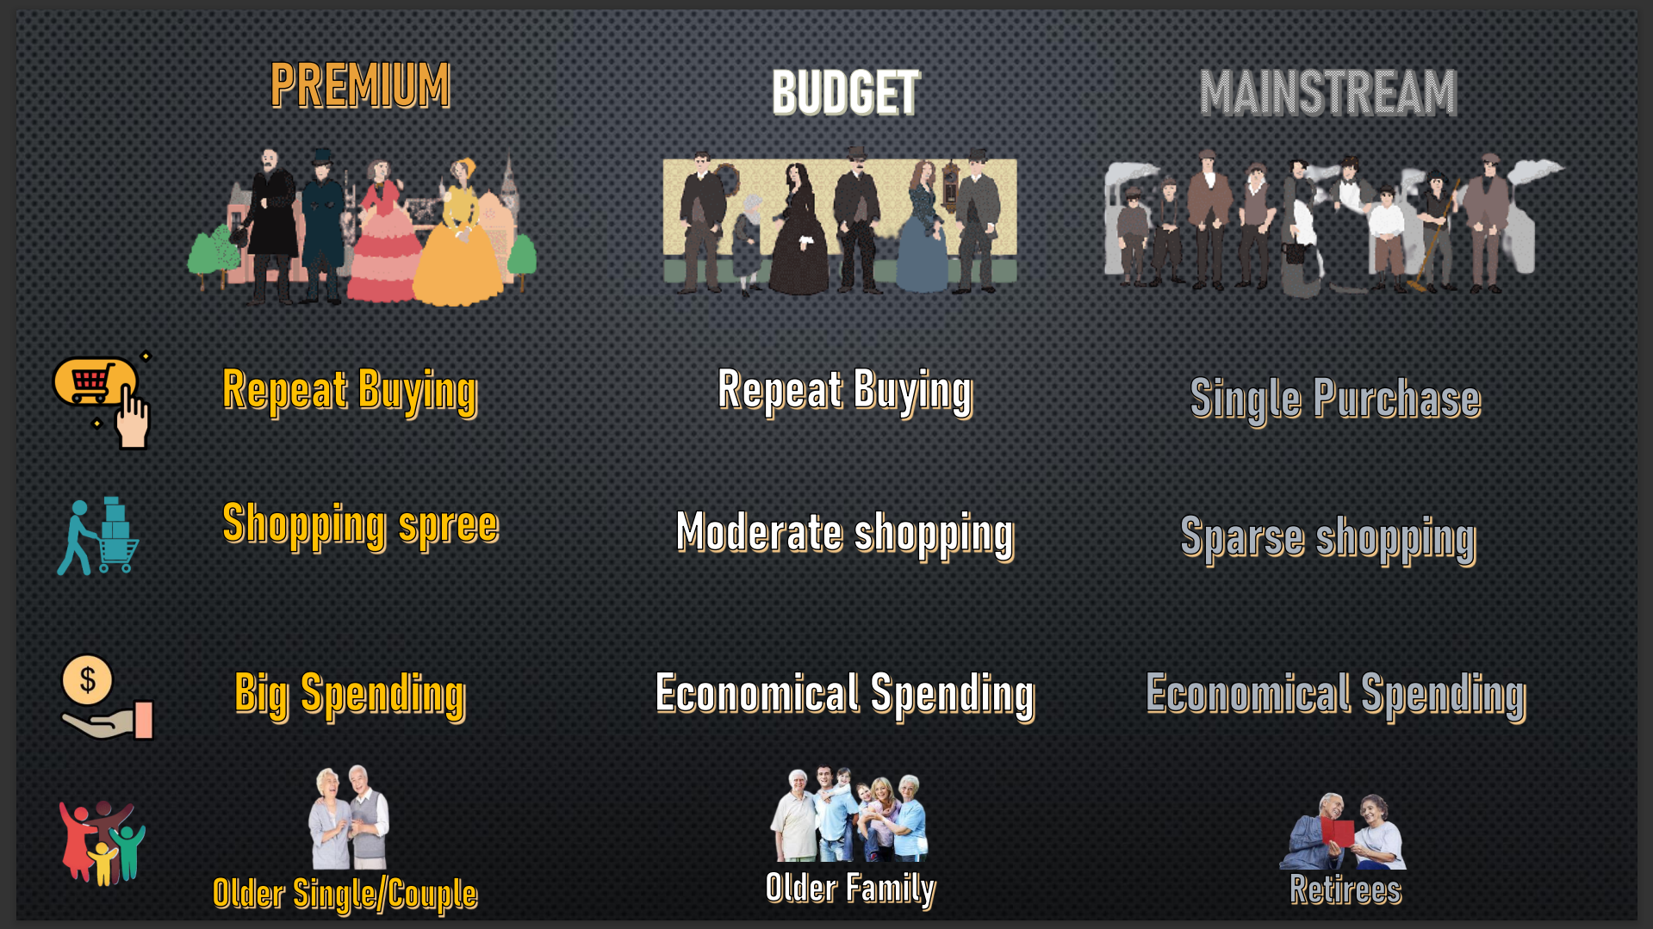
Editable (delete this)
Understand buying behavior of three customer segmentation
From the RFM analysis, we can decipher their buying behavior and here are the results:

Slide 10
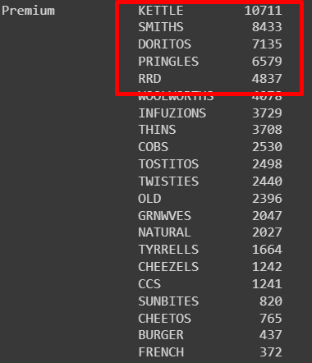
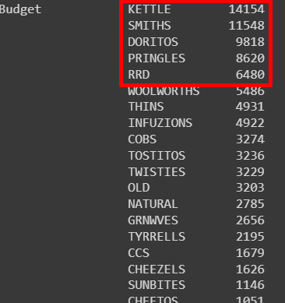
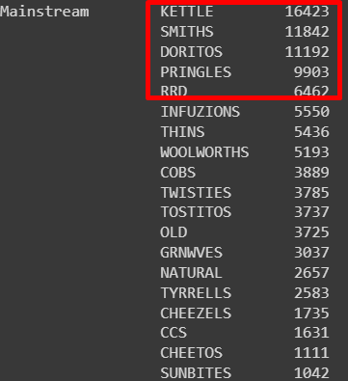
From customer segmentation, it is likely that their preferred brands are the same.

Slide 11
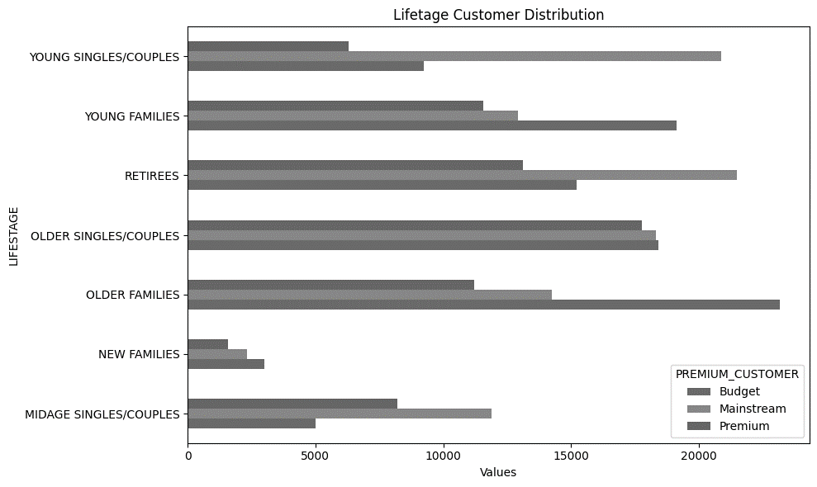
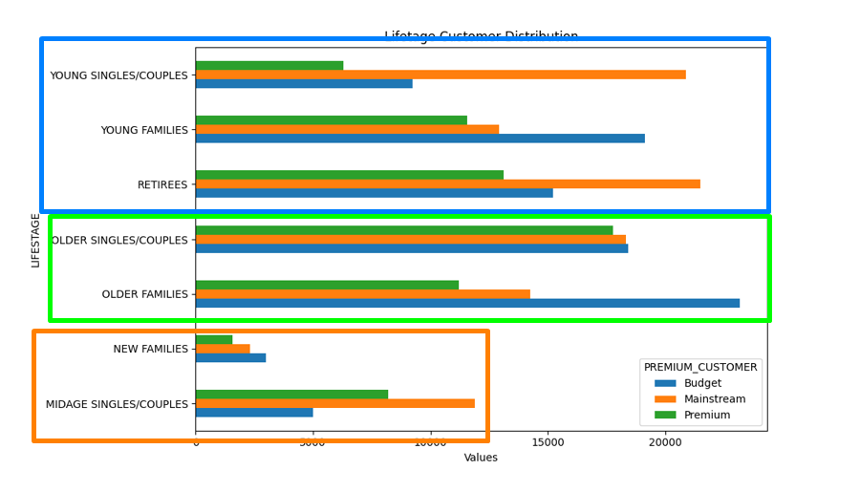
Based on the lifestage customer distribution, we can conclude that the ancient families are the wealthiest, while the teenage families and retirees fall into the middle buyer category.

Slide 12
04 Conclusion and Recommendation

Slide 13

Conclusion :
No matter the family lifestage or customer segmentation, it is likely that their preferred brands are the same.
Ancient families are the wealthiest, while the teenage families and retirees fall into the middle buyer category.
Most of the buyers are mainstream customers, which refers to new families or young families. This indicates that most retail businesses cater primarily to ancient families

Slide 14

Recommendation:
Offer a monthly discount for chips.
Revamp the retail store to create an appealing environment for young families
Run some promotions targeted at new families.
Create a membership program for premium families.

